Slide 1

First Medical Responders Website
Indian Red Cross Society
Manit Gupta
Gyanendra Mishra
Shubham Agrawal
Anubhav Gupta

Slide 2
About : First Medical Responders
First Medical Responders are trained volunteers with the capacity to respond to emergency situations.
These volunteers and staff will be trained and equipped to address needs of their local communities.
Their responsibilities include providing first aid, water, sanitation and hygiene promotion, public health, and psychosocial support.

Slide 3
Number of First Medical Responders

Slide 4
The Problem
All the information about First Medical Responders (FMRs) is currently managed manually.
Gathering data from over 700 branches across 35 states and Union territories is a cumbersome task.
It requires a lot manual labour and paper.
It is time-consuming to contact FMRs during disasters.
The process is inefficient and needs to be optimized.

Slide 5
Value Proposition
An online Resource Management System (RMS), which allows easy access to data 24X7, on both mobile and Desktop Platforms (Windows).
Simple way to view, update and delete information about FMRs.
Access to National, State and District Level users by way of individual Logins. Access to features of the website based on clearance levels.
Contact all FMRs of a state at once via E-mail.

Slide 6
Target Users
Employees of Red Cross in the 700 branches of Red Cross all over the country.
Assumption is that majority of the target audience is not tech-savvy
Need for a simple and easy-to-use interface.
Slow Internet connections require a website with minimal server overhead to improve loading times.

Slide 7
Features
Add/View/Edit/Delete Information on FMR’s.
Import/Export Excel Sheet.
Search the database based on 4 different criteria.
Contact all FMR’s of a particular state via E-mail.
Add/View new State and District Users.
Separate Views for users with different clearance levels.
Change Password and Account Details.
Forget Password functionality.

Slide 8
Platform
The website is built using the following platforms:
Backend
PHP
MySQL
Frontend
HTML
CSS
JavaScript (jQuery)

Slide 9
Access Levels
Login
National
Add/Edit/Update
State
District
Add/Edit/Update
All States
Add/Edit/Update
Respective State
Respective District

Slide 10
Sitemap
Add Responders
Excel Upload
Form
View Responders
Sort
Edit/Delete
Search
Name
Year of Training
Districts
State
Control Room
New State User
New District User
View State and District User
Settings
Account Details
Change Password
Last Edited by

Slide 11
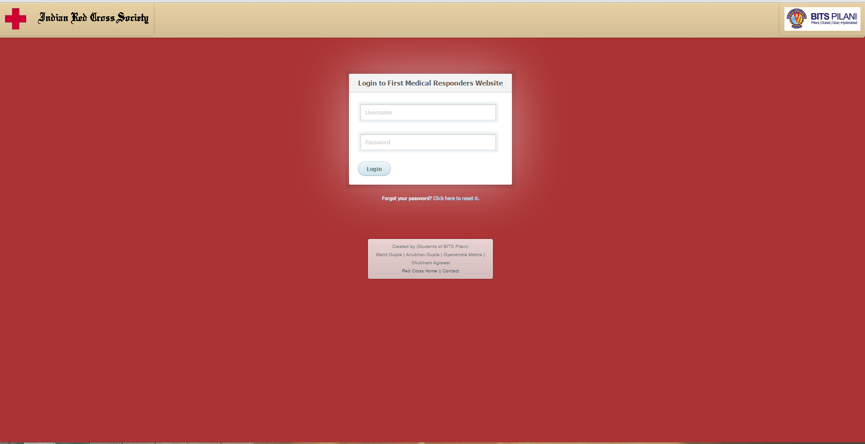
Website UI: Login

Slide 12
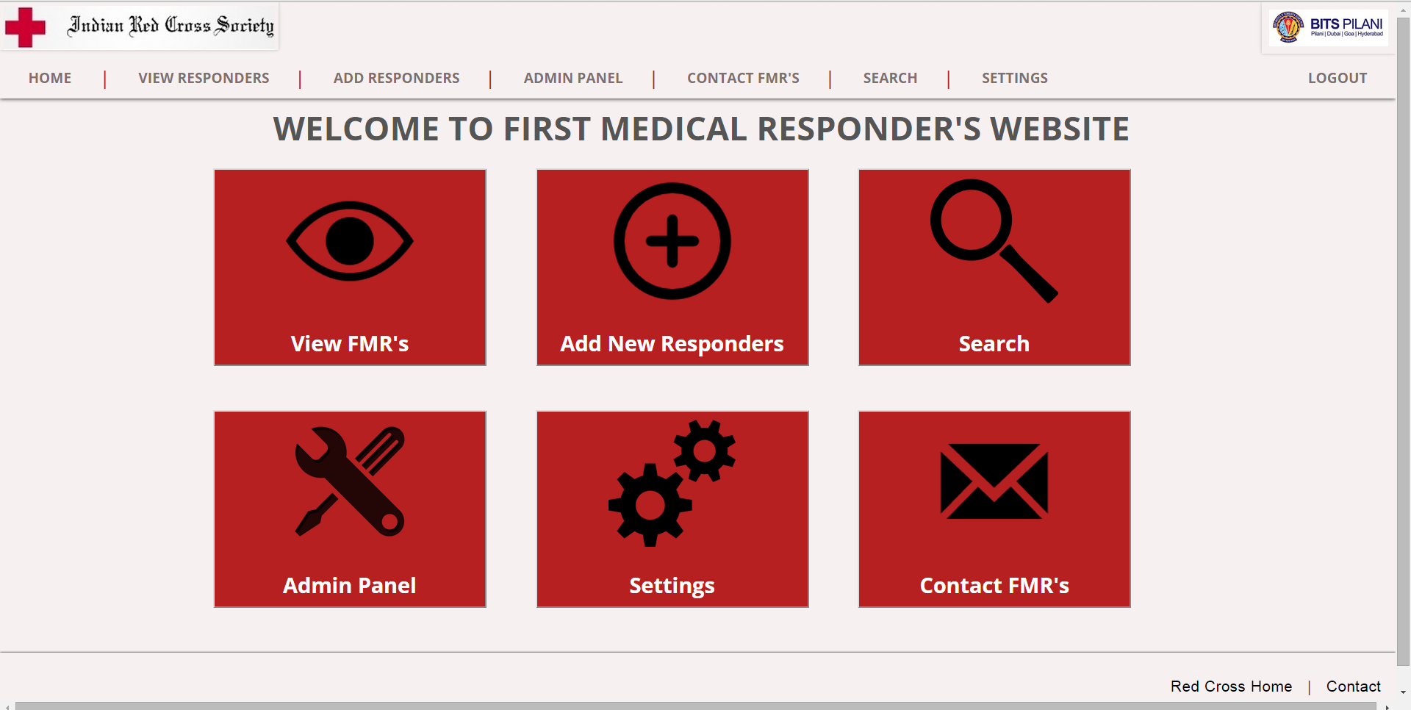
Website UI: Home Page

Slide 13
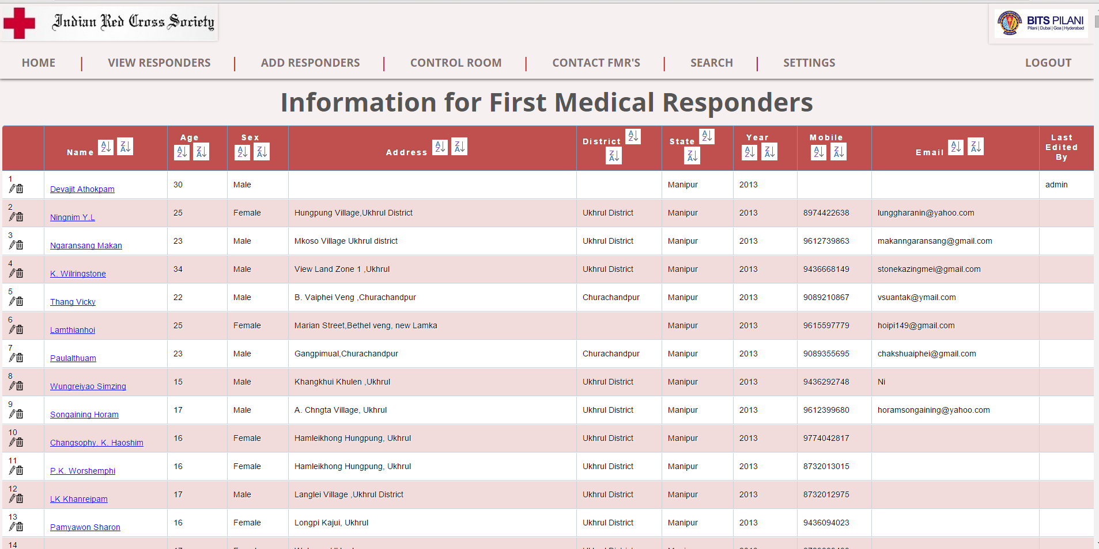
Website UI: View Responders

Slide 14
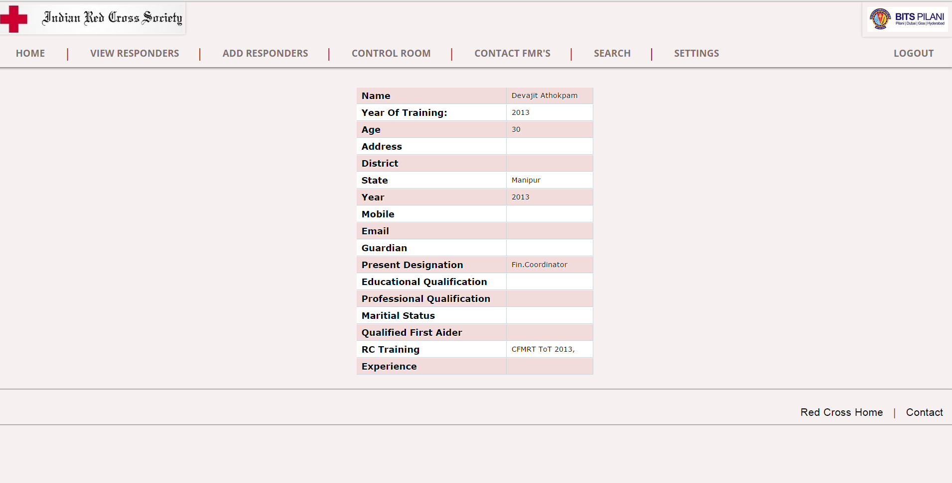
Website UI: View Details

Slide 15
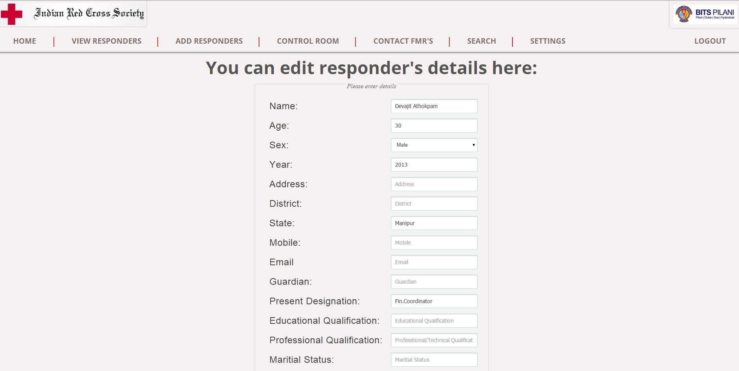
Website UI: Edit Responders

Slide 16
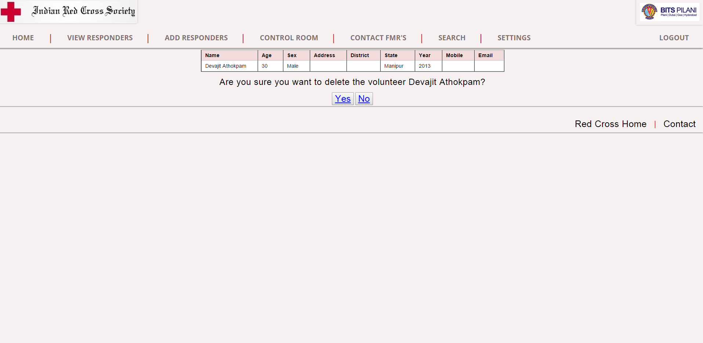
Website UI: Delete Responders

Slide 17
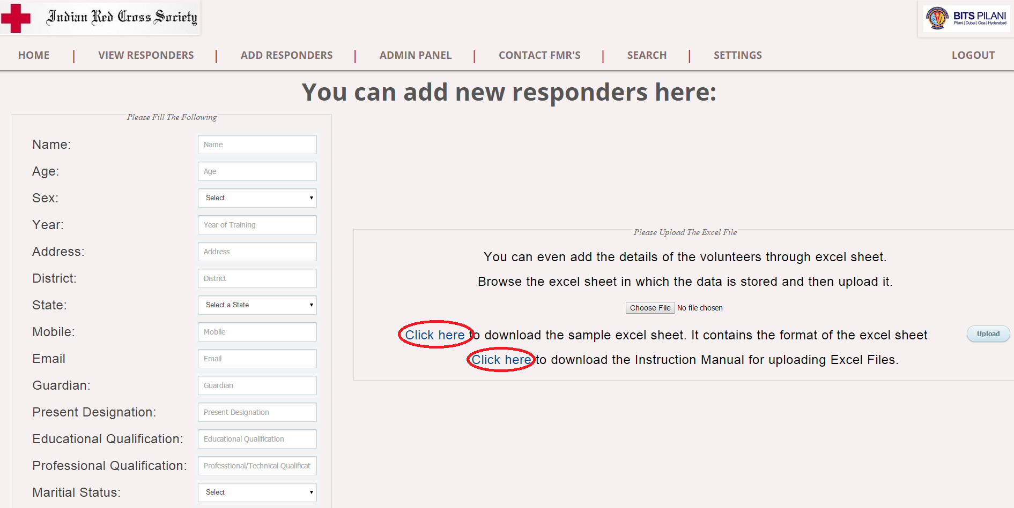
Website UI: Add New Responders

Slide 18
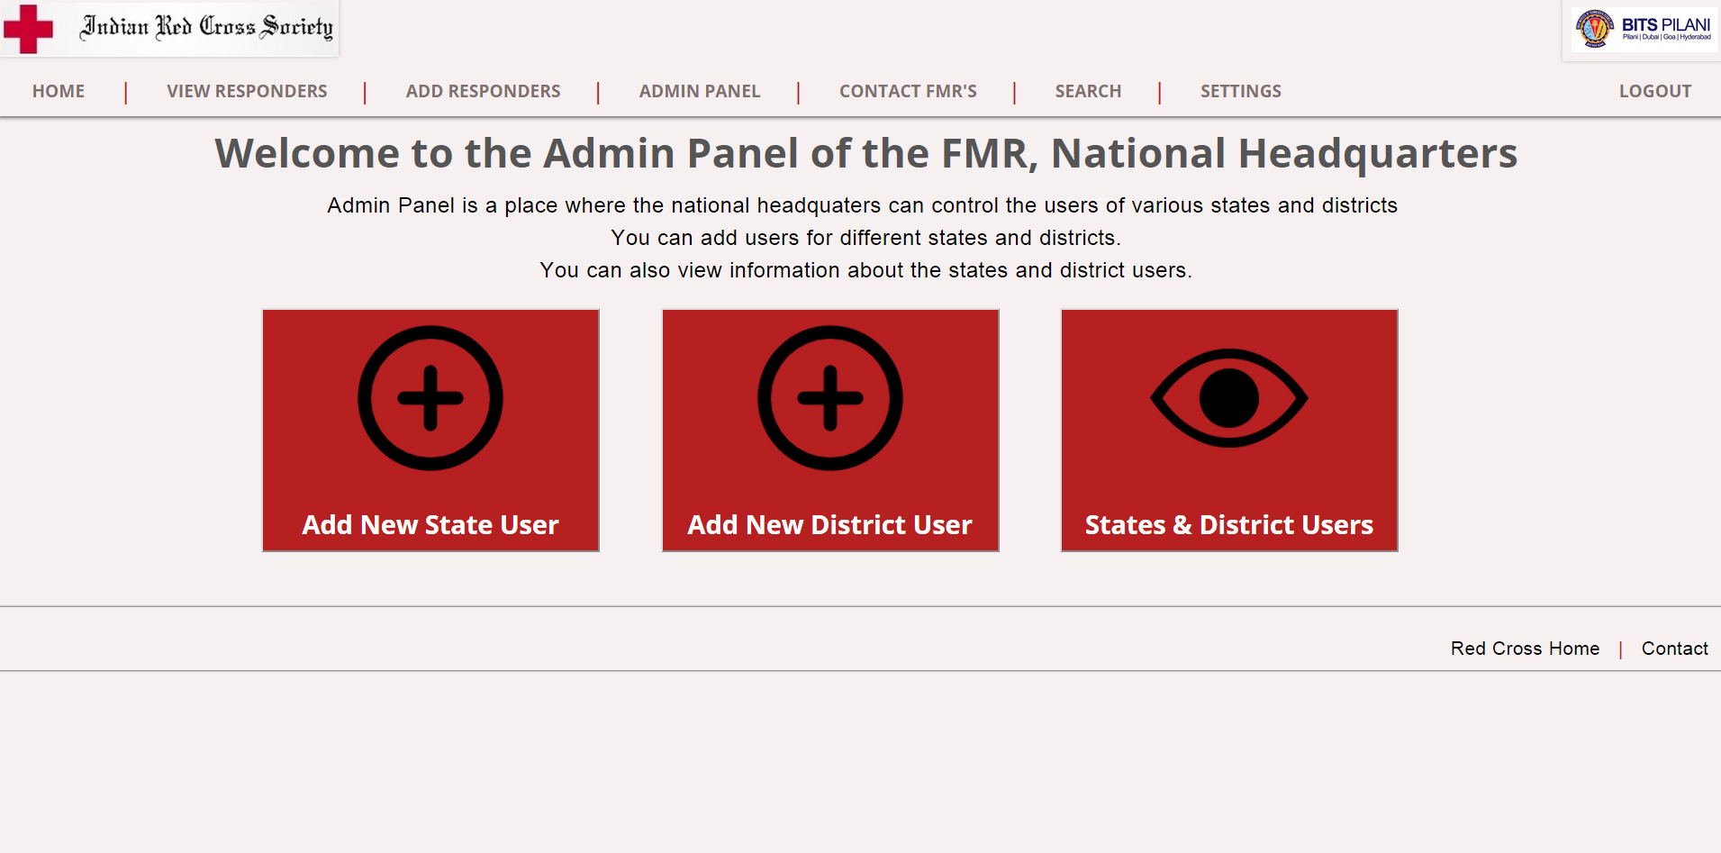
Website UI: Admin Panel

Slide 19
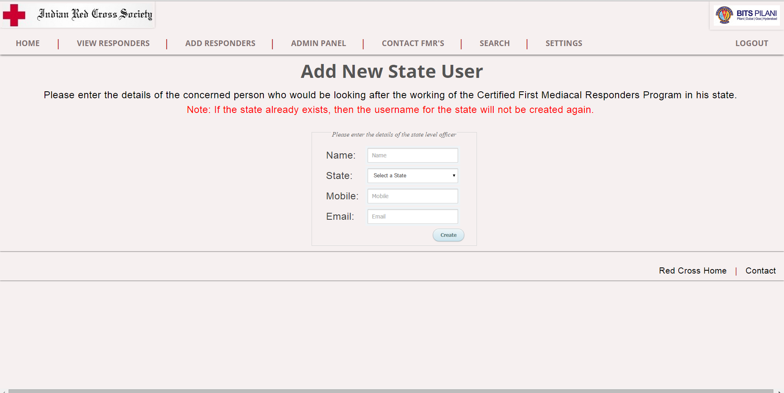
Website UI: Add New State User

Slide 20
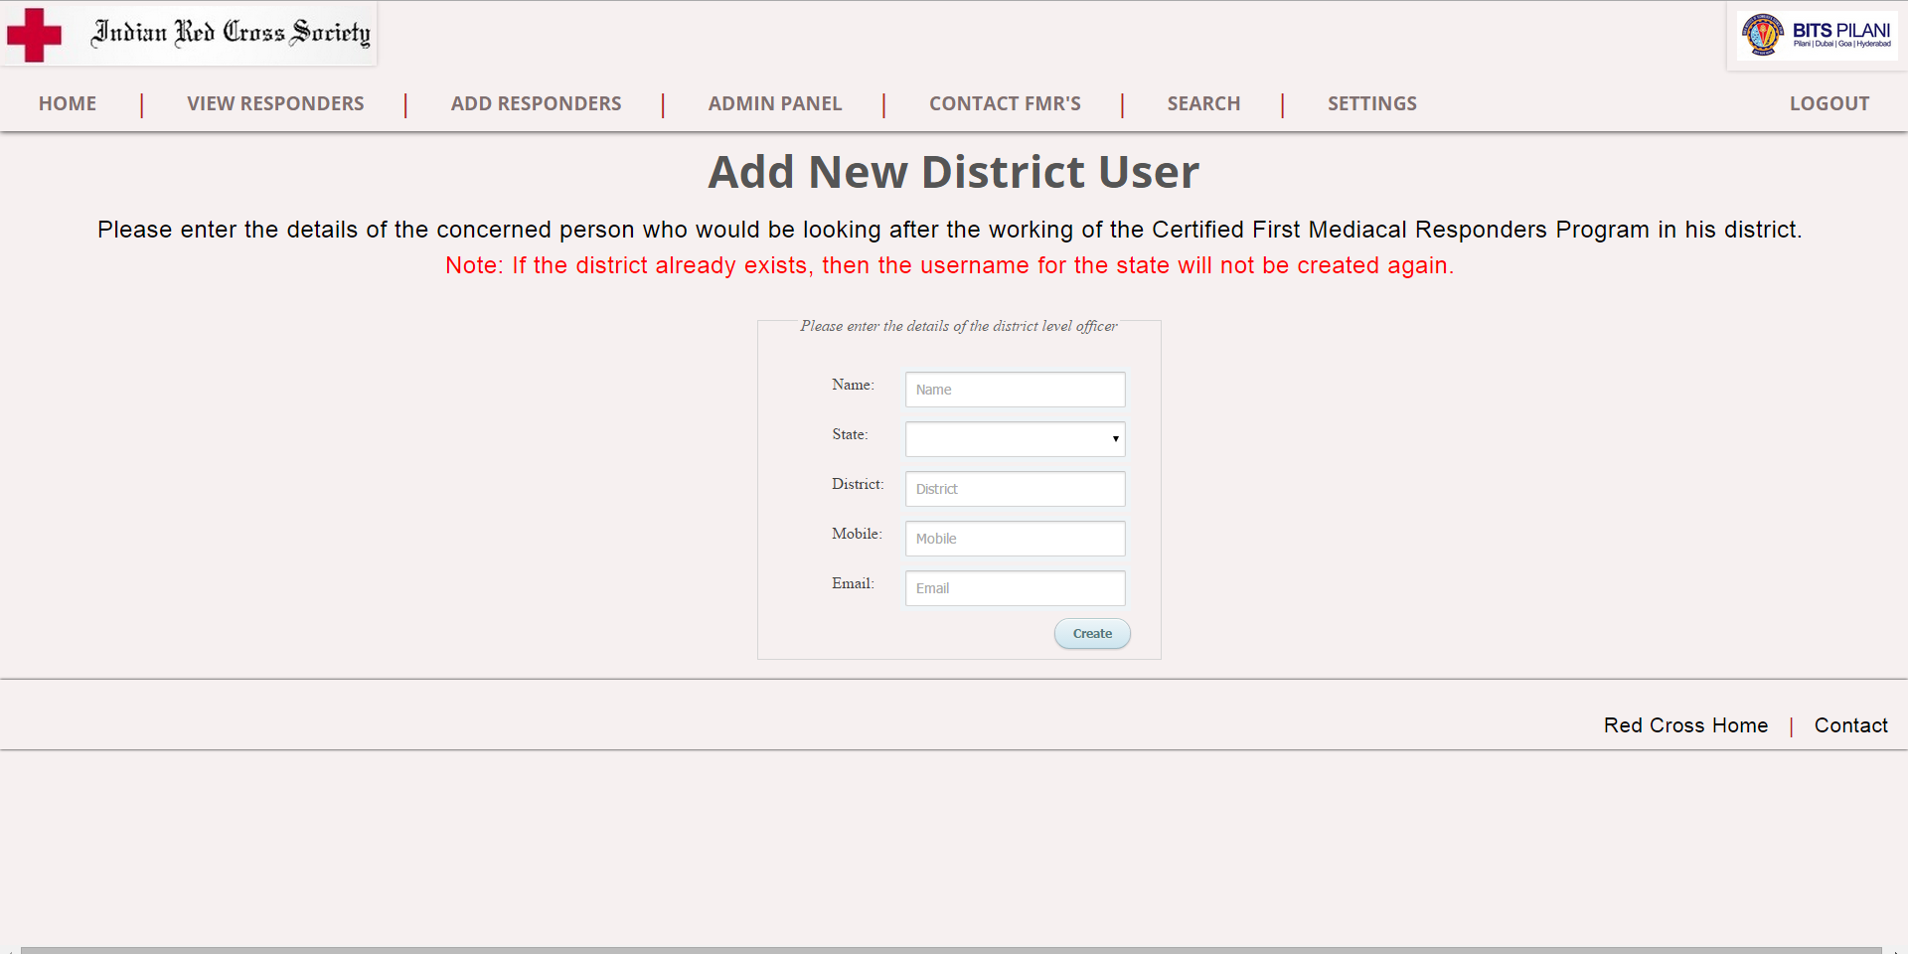
Website UI: Add New District User

Slide 21
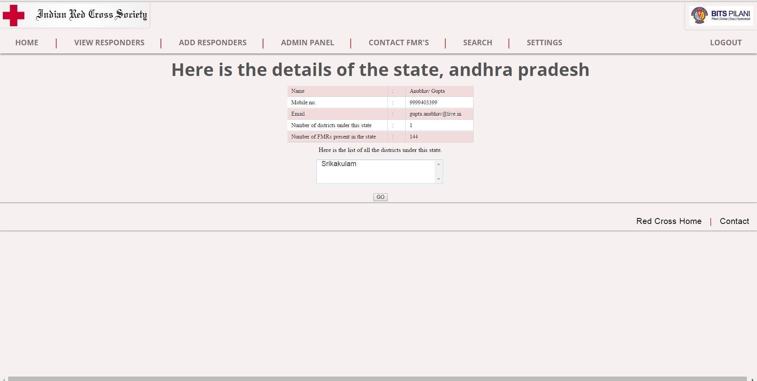
Website UI: View State & District Users

Slide 22
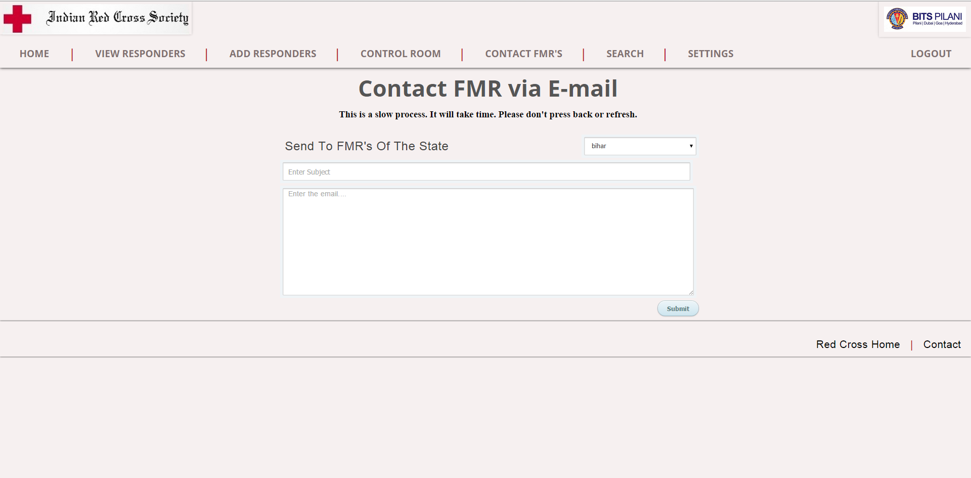
Website UI: Contact FMR’s

Slide 23
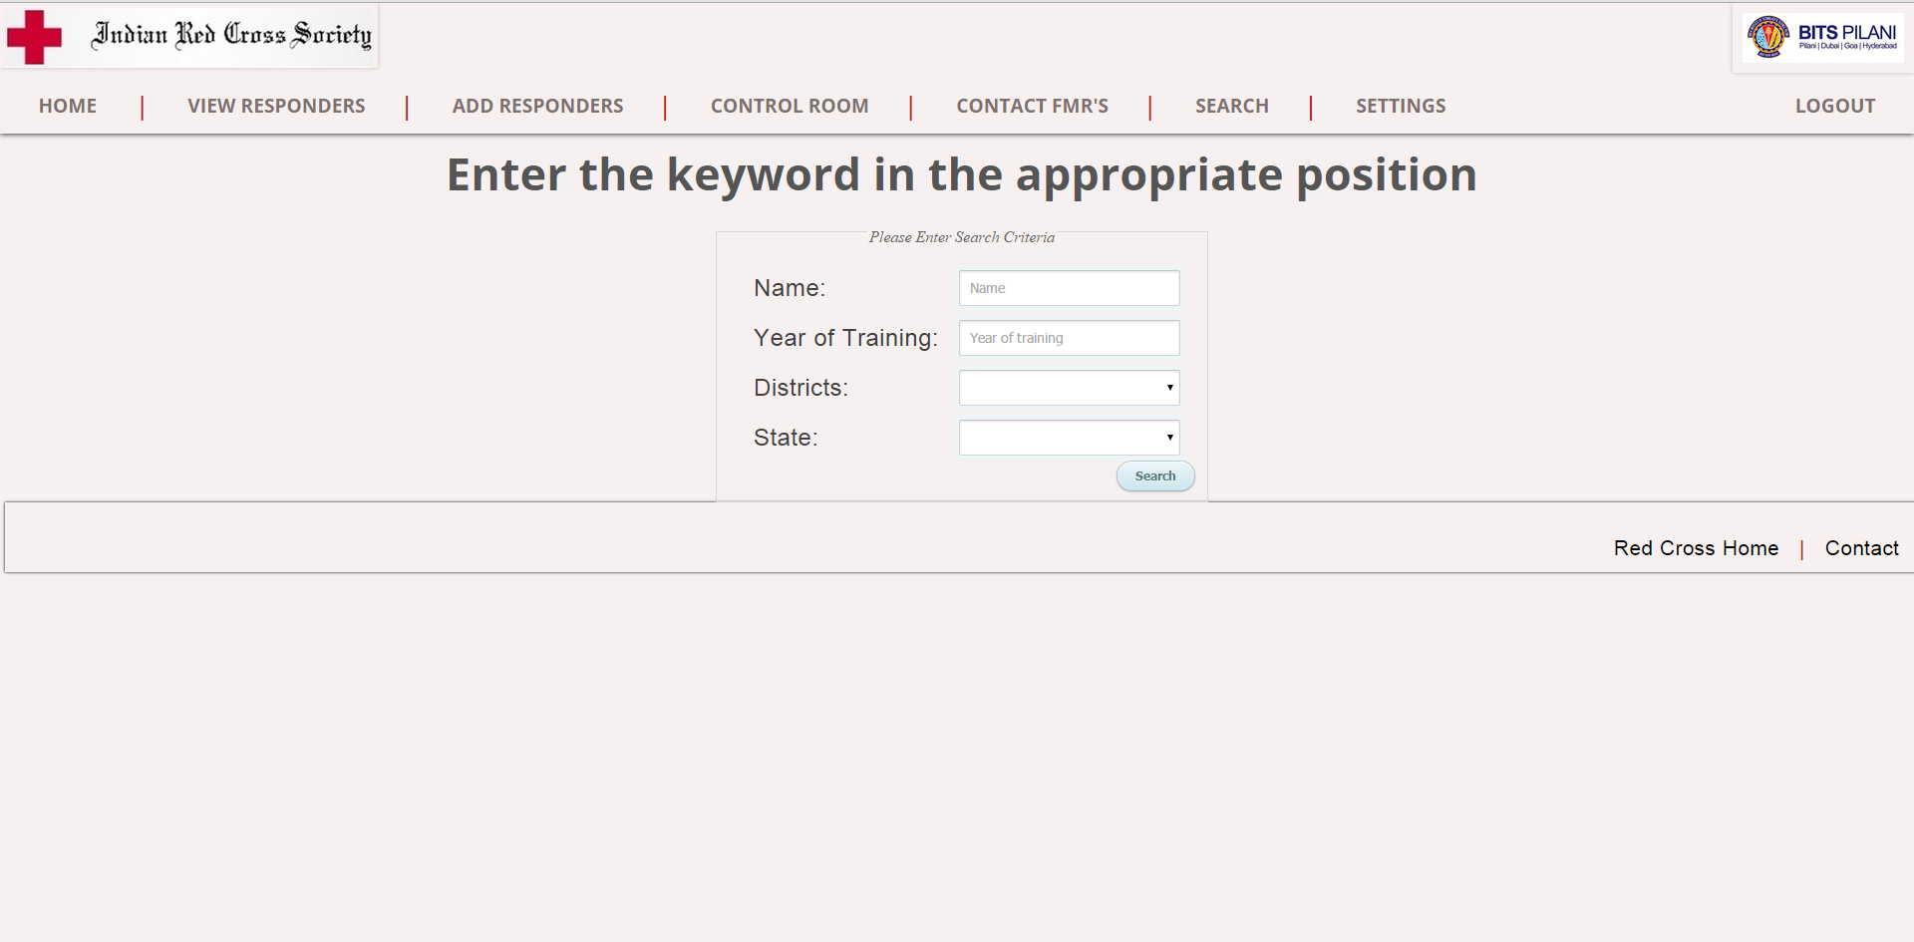
Website UI: Search Responders

Slide 24
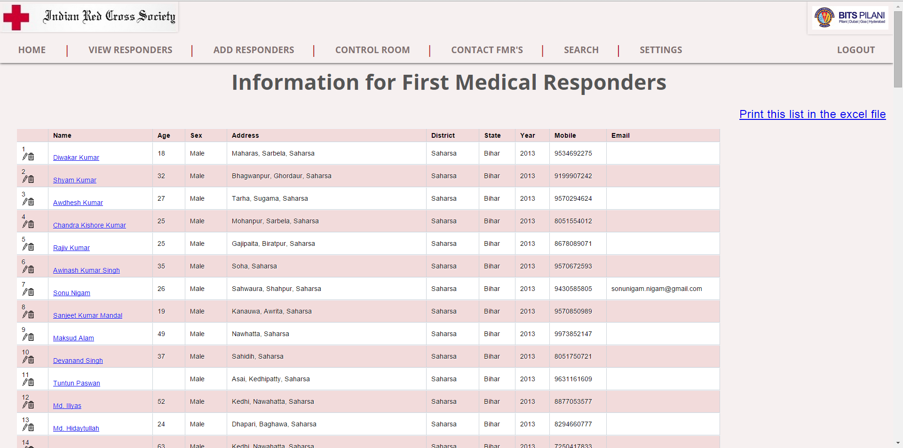
Website UI: Search Results

Slide 25
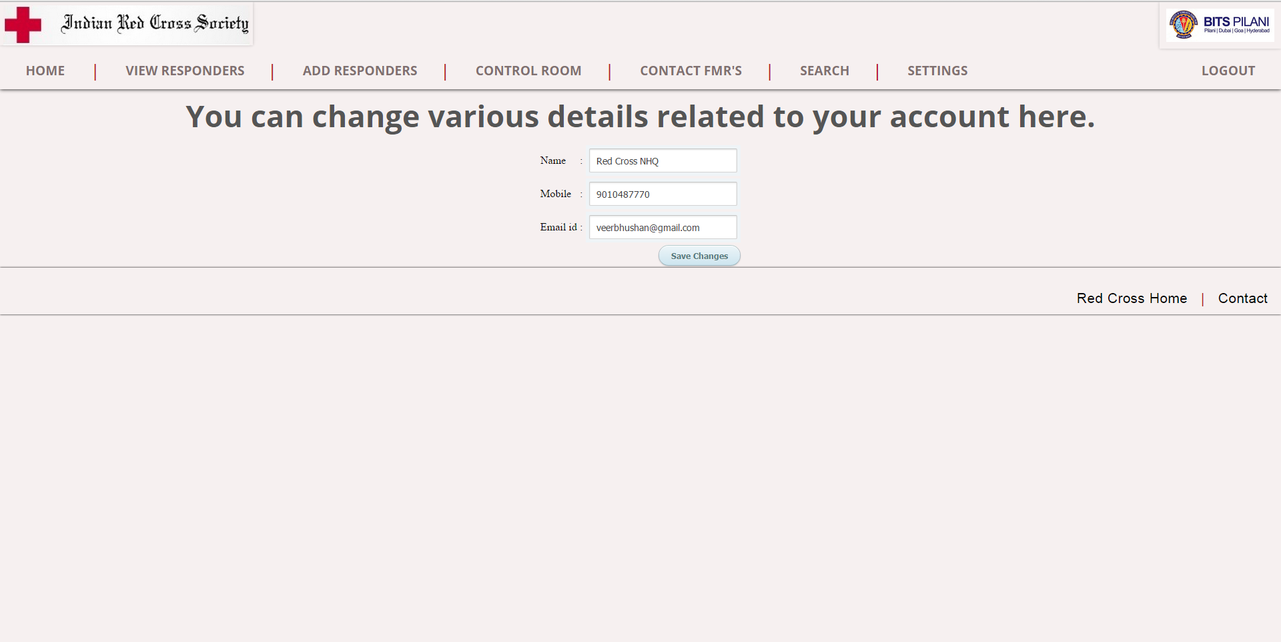
Website UI: Settings

Slide 26
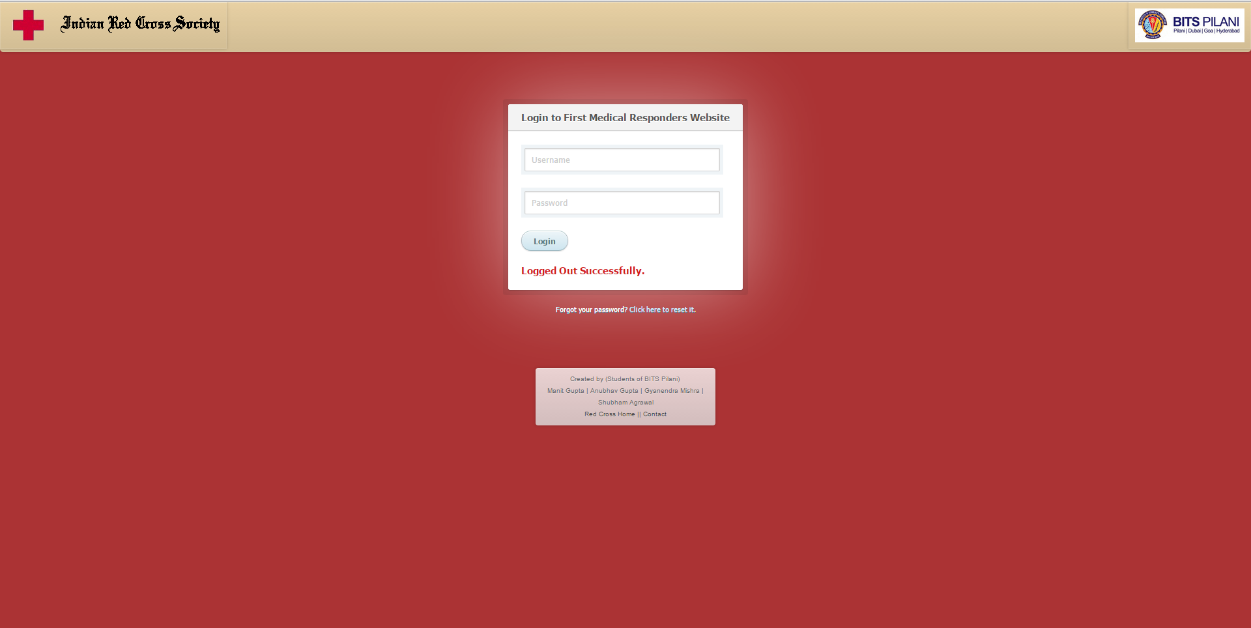
Website UI: Logout

Slide 27
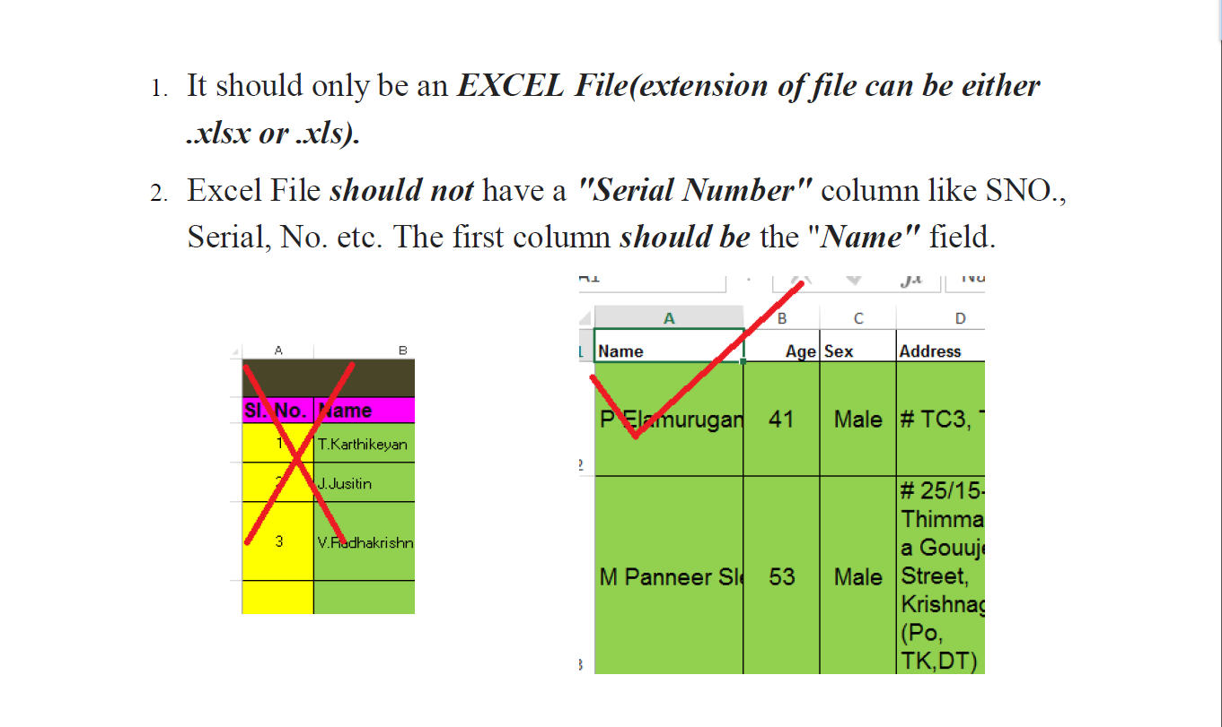
Instruction Manual : Excel Upload

Slide 28
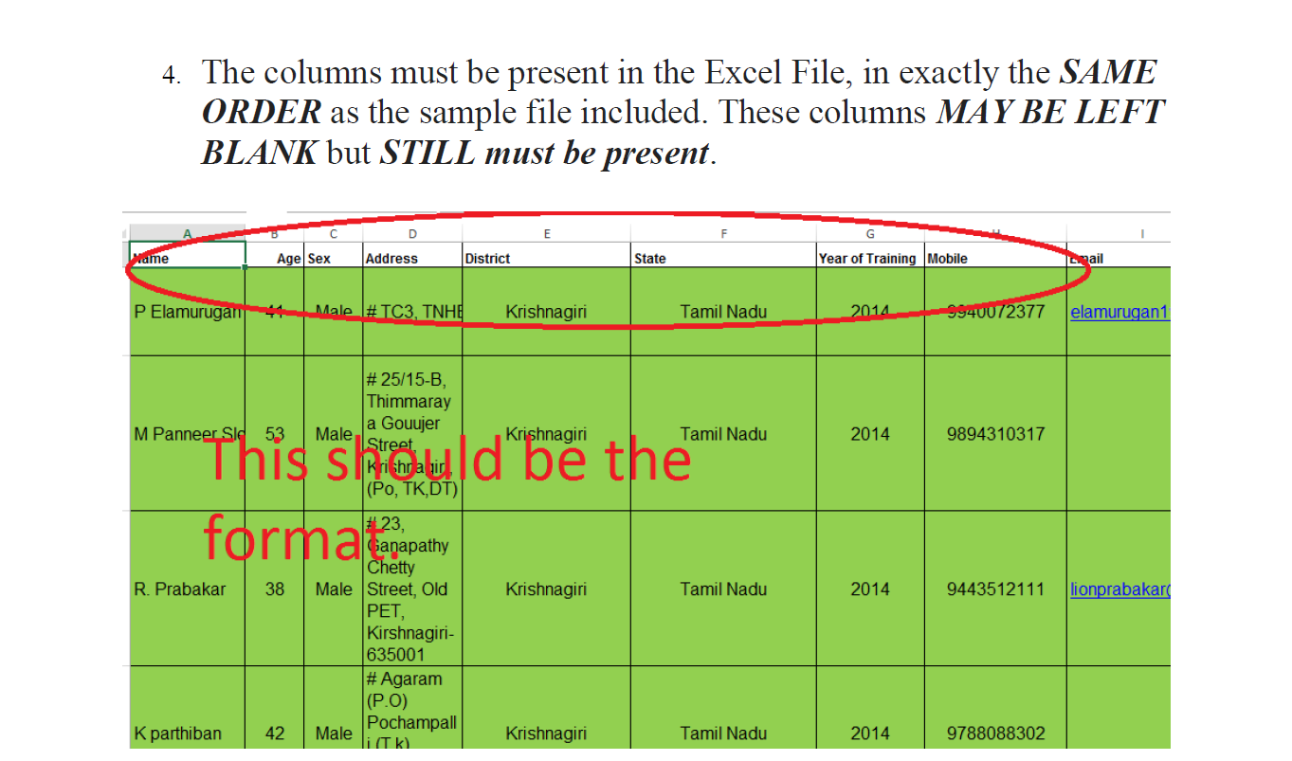

Slide 29
End

